Slide 1
BeagleDust

Slide 2

BeagleDust
Concept and business case
Premier Farnell and BeagleBoard.org
December 2018

Slide 3
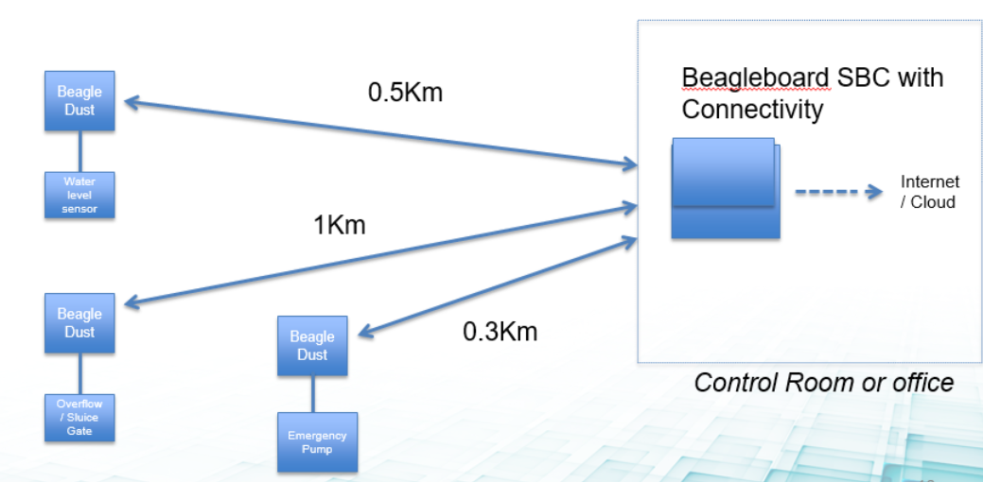
The Concept
Digital Dust -> A low cost sub $10, low-profile edge node that is easily deployed almost anywhere
Sub 1GHz network based on TI-15.4 stack
User experience is simple and seamless with out of box setup taking minutes
Adaptable by Makers and Professionals alike for it’s plug and play usability
Professionals would use for proof of concept, assume higher volumes would result in design / manufacturing customization opportunities and the wider portfolio of IoT services
<number>

Slide 4
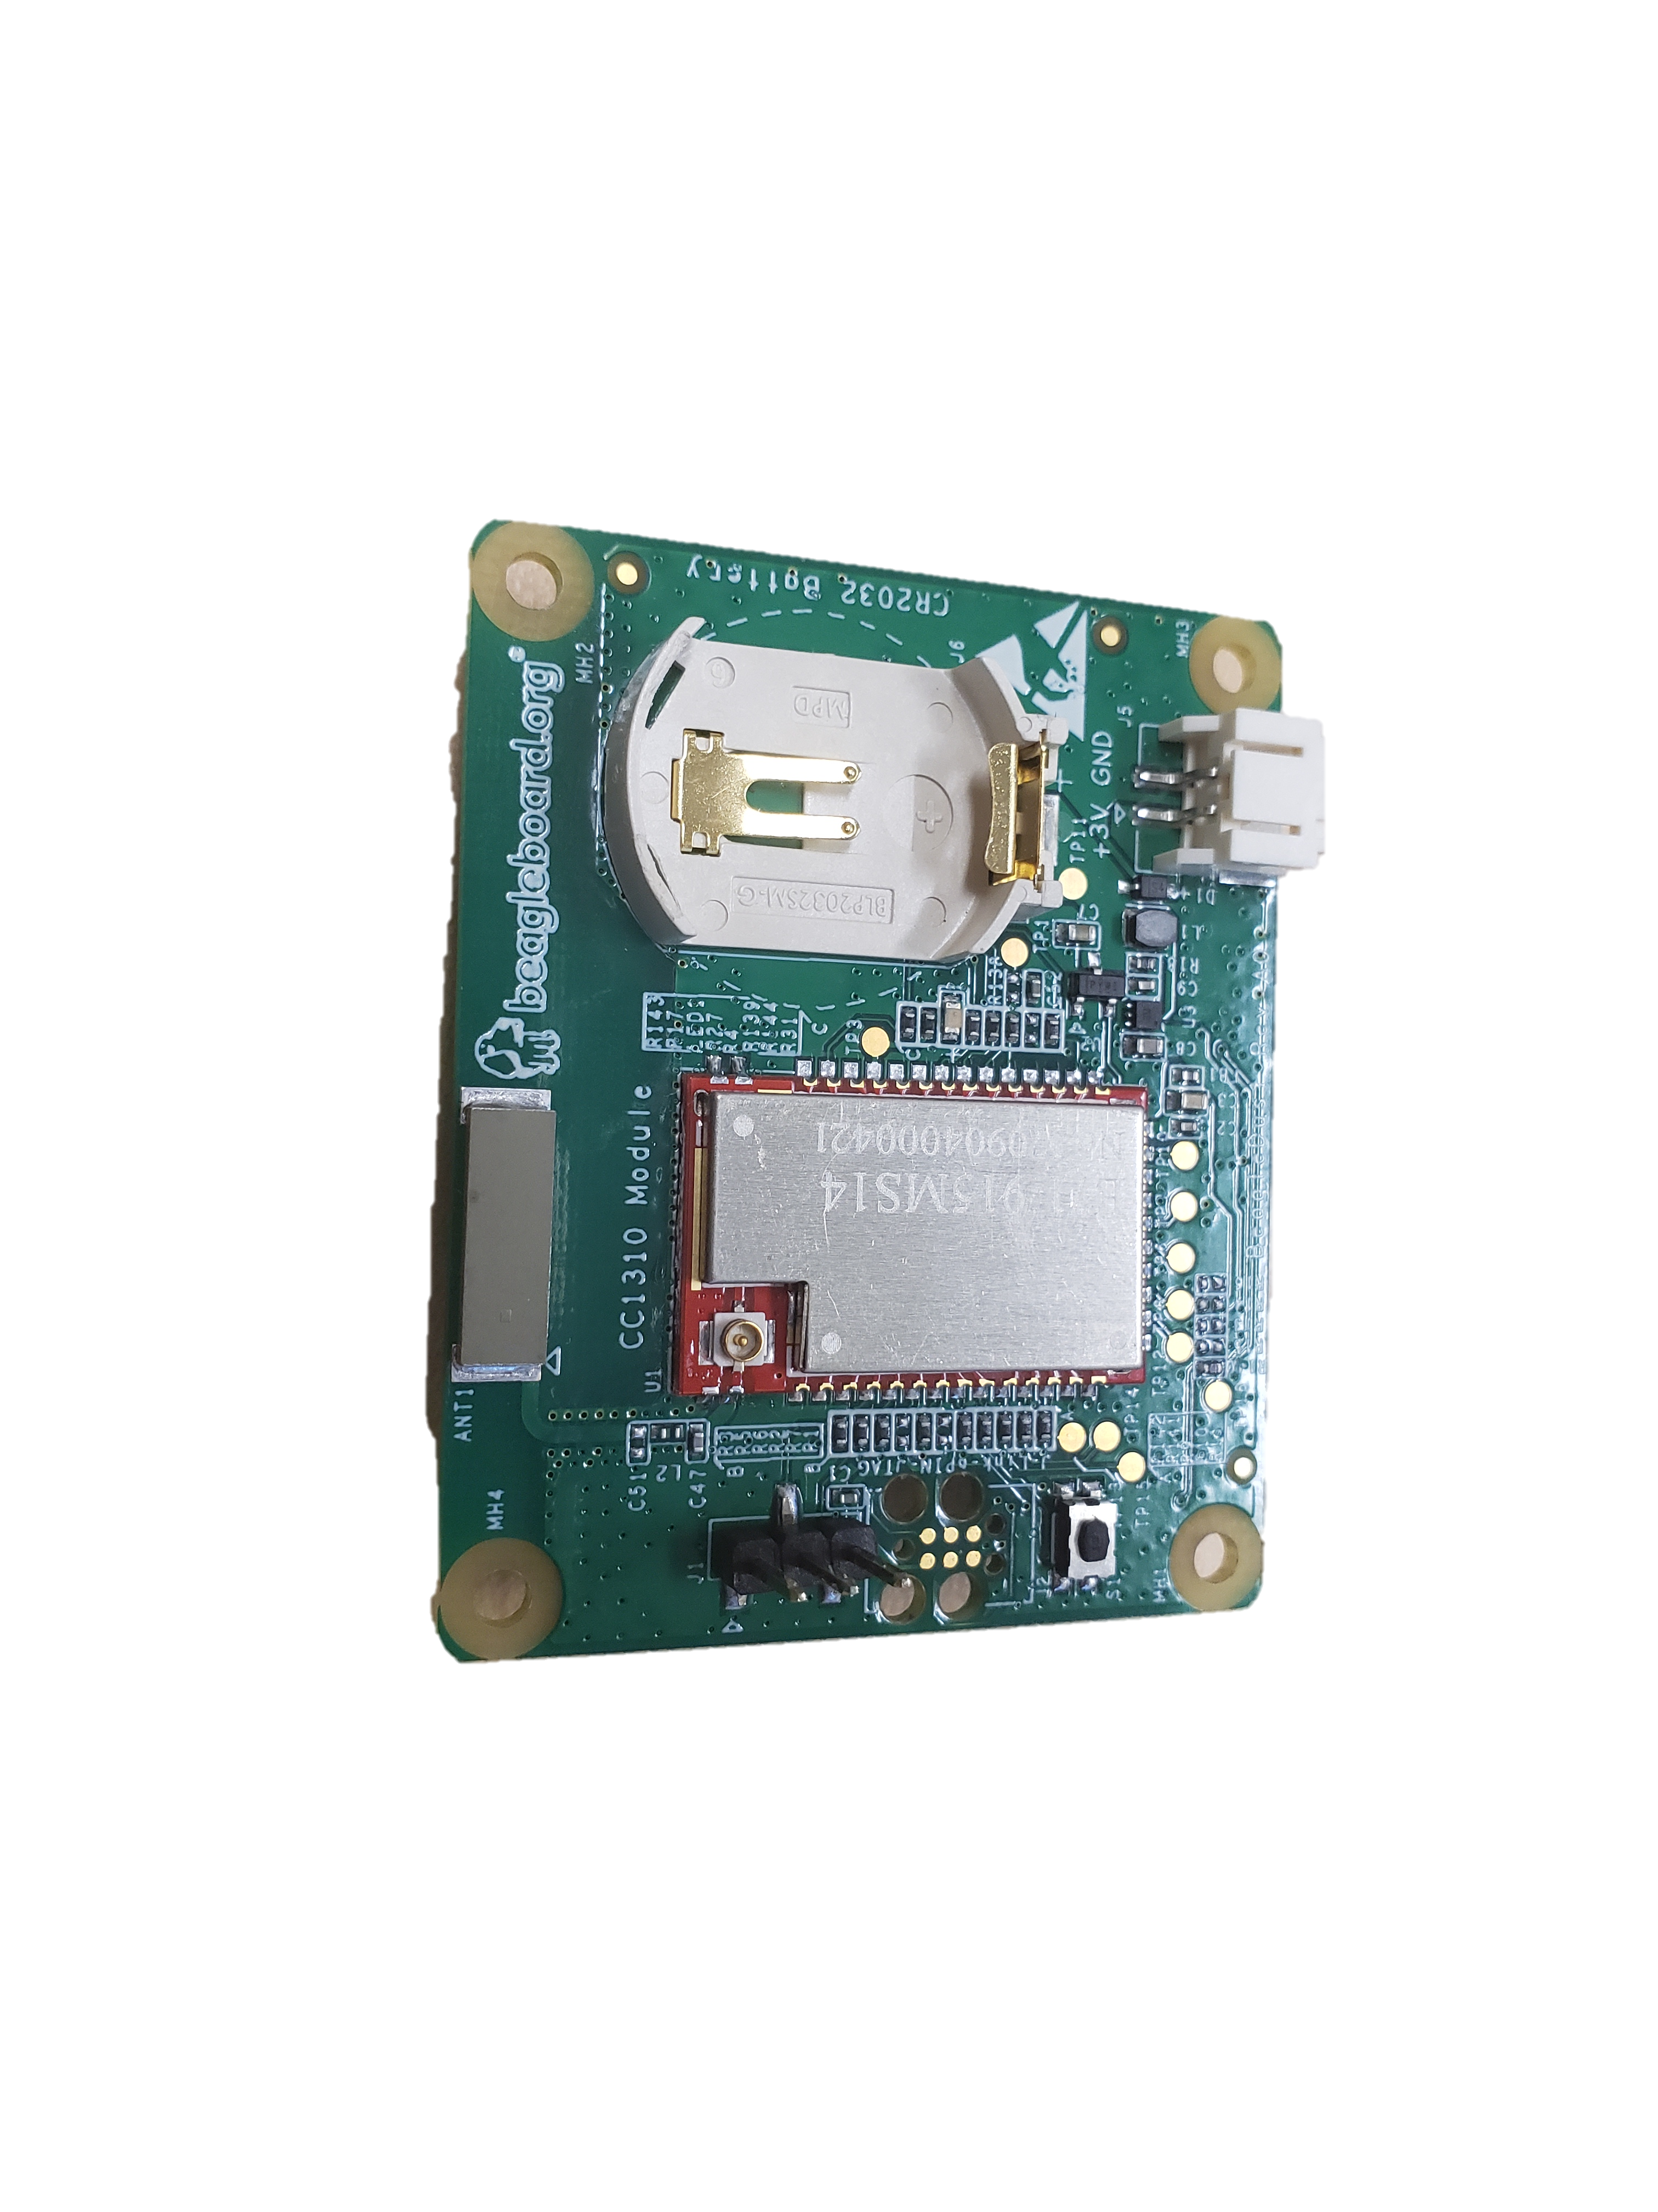
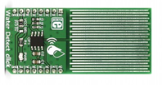
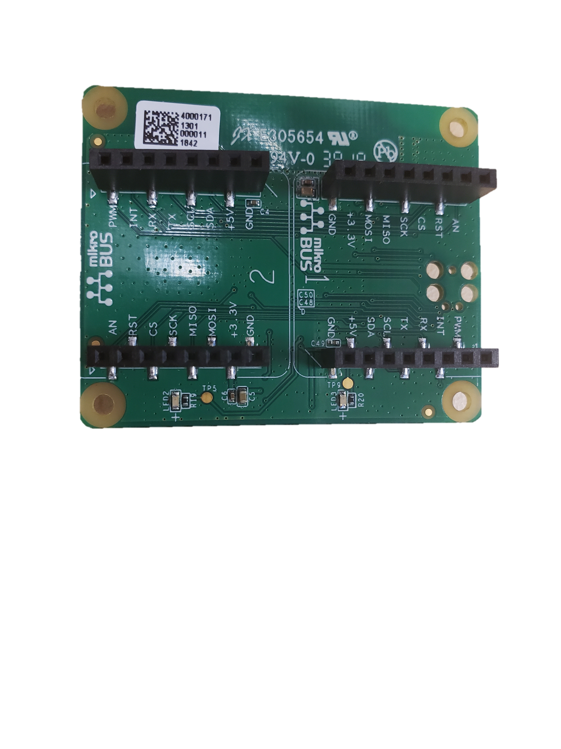
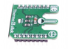
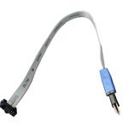
BeagleDust Feature Set
FRONT
BACK
Power
Coin Cell Battery
CC13xx Module
2x mikroBUS Headers
Click Boards
cJTAG
<number>

Slide 5

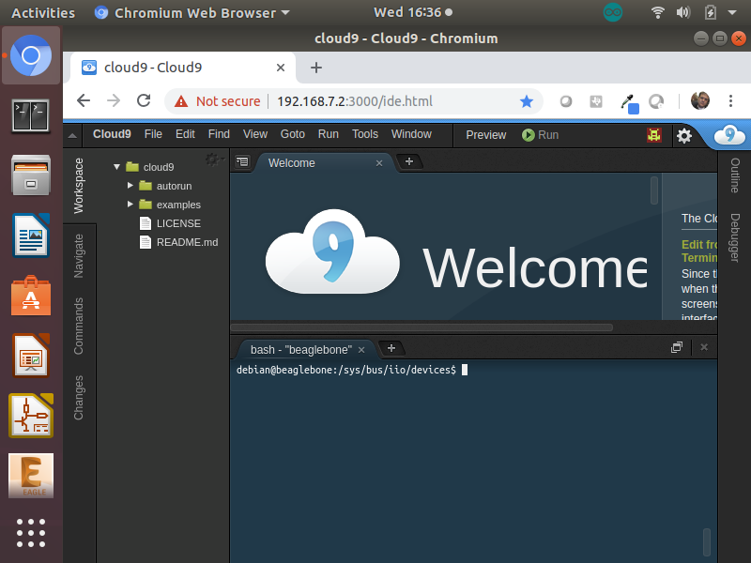
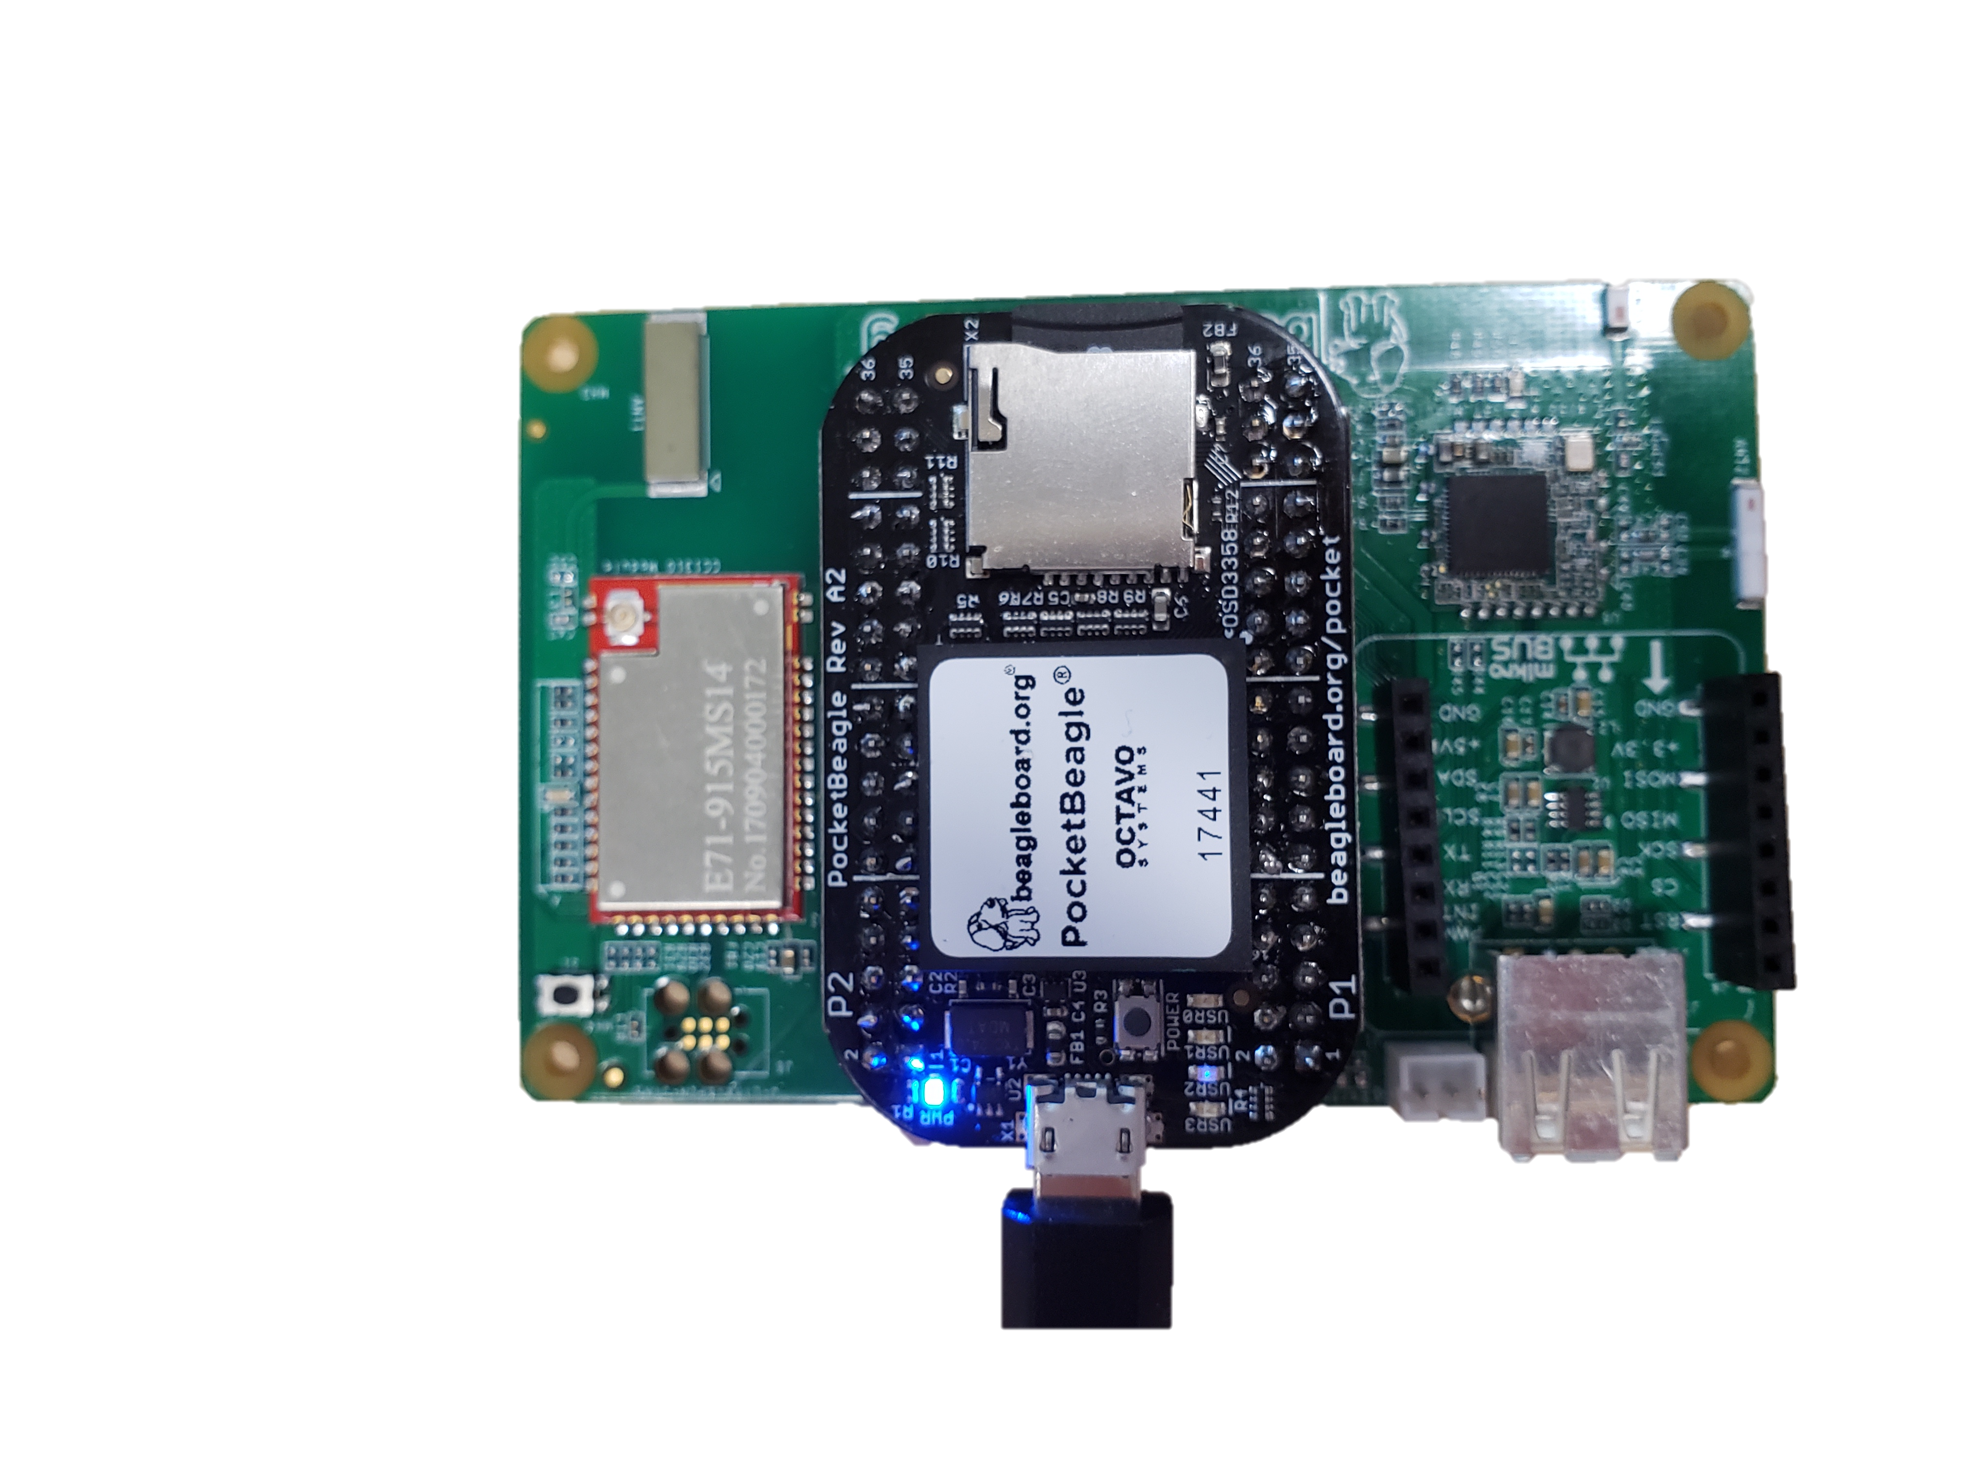

The User Experience
Step 1 – Gateway login
IDE
Gateway
SensorTag
<number>

Slide 6

The User Experience
Step 2 – Connect with button push
IDE
Gateway
SensorTag
<number>

Slide 7
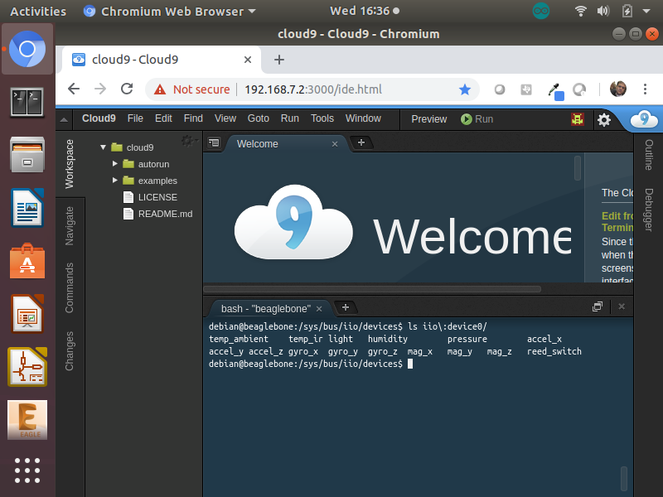
The User Experience
Step 3 – Live edge data automatically appears
IDE
Gateway
SensorTag
<number>

Slide 8
The User Experience
Same firmware, infinite sensors
BeagleDust
IDE
Gateway
SensorTag
<number>

Slide 9
User Experience Value Proposition
Automatic provisioning for I2C, SPI, GPIO, UART, ADC, and PWM
No cut-and-paste
No device specific code lives my program
Driver maintenance is owned by Linux kernel
No “firmware” development
Everything a developer needs to do sits above the OS in any language
All sensor data is readily accessible in read and write files
Every programming language supported
No language specific libraries
Out of the box support for ecosystem of 500+ mikroElektronika click boards
<number>

Slide 10
The Ask
Marketing Support
How can TI drive market awareness – what does TI need from BB.org to do this?
Software and Hardware Development
Design support and consultancy for discrete implementation of CC13xx
Required to achieve pricing targets
Split cost of 6 months firmware development, ~$150k
Pricing
Target BOM cost is $3 to achieve a MSRP of <$10
<number>

Slide 11
Appendix
<number>

Slide 12
Example: flood mitigation system
BeagleBoard SBC with Connectivity
Beagle Dust
0.5Km
Water level sensor
Internet/ Cloud
1Km
Beagle Dust
Beagle Dust
0.3Km
Control room, office or
enclosure
Overflow/ Sluice Gate
Emergency Pump
<number>

Slide 13
Software Proposition
Greybus: automatic provisioning for I2C, SPI, and GPIO
USB in Linux Today
Before Greybus
With Greybus
HOST
Peripheral
Connect Device
Probe
what is it
SOC
I2C
Peripheral
SOC
I2C
Peripheral
Tell it
UART
MCU
MCU
SPI
SPI
Load
Driver
GPIO
GPIO
It Works!
Specific device tree required
Connect Device
Probe
what is it
Manifest
<number>

Slide 14
The Concept
Low cost (< $10), low-profile edge node that is easily deployed almost anywhere
Adaptable by Makers and Professionals alike for it’s plug and play usability
Professionals would use for proof of concept, assume higher volumes would result in design / manufacturing customization opportunities and the wider portfolio of IoT services
Features Long Range Radio comms (Sub-GHz TI 15.4 compare with LoRA) module with on-board MCU for control and uFL connector
Low power with ample GPIO for easily sensor attachments
Compatible with MikroBus interface, allowing for deployment of MikroE click sensor & actuator boards
Works (& communicates) out-of-the-box with PocketBeagle or BBB, enabled with their respective Long Range Comms cape
Debug / Programming via header / JTAG connector / USB option(s)
Battery-holder for Li-Ion coin-cell
Power-management with appropriate voltage translations
<number>

Slide 15
What is probing and a probable bus?

Slide 16
Example: flood mitigation system
PocketBeagle + Connectivity Cape
Beagle Dust
0.5Km
Water level sensor
Internet/ Cloud
1Km
Beagle Dust
Beagle Dust
0.3Km
Control Room or office
Overflow/ Sluice Gate
Emergency Pump
<number>

Slide 17
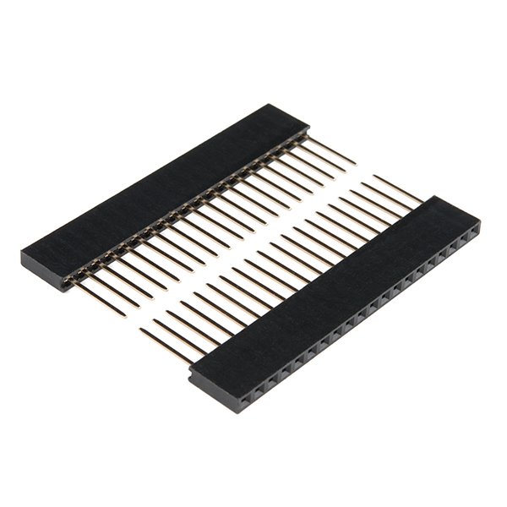
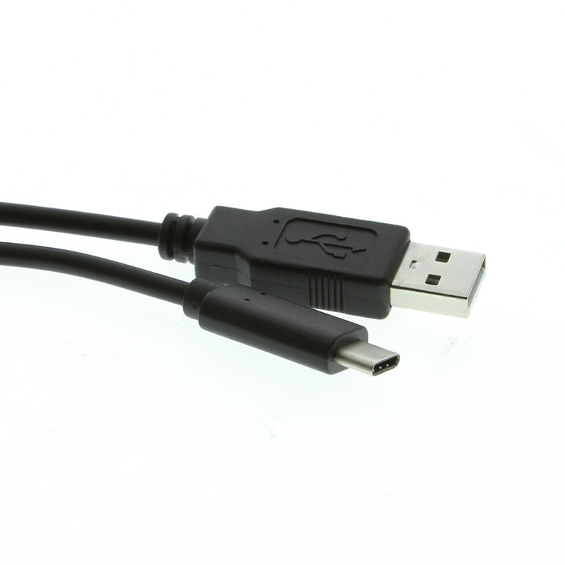
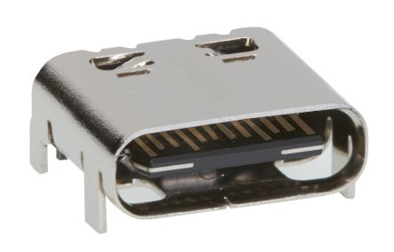
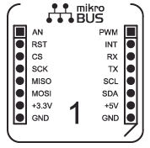
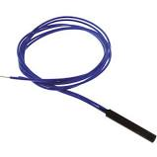
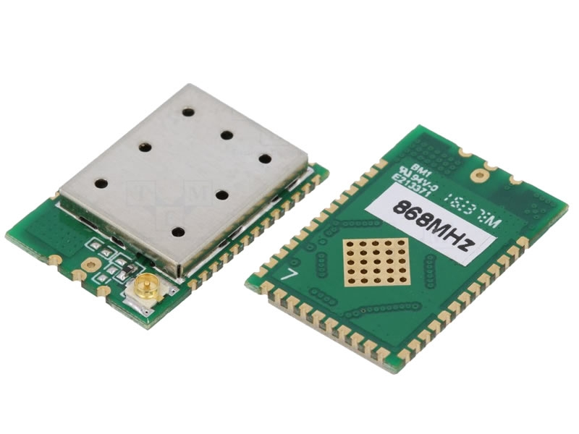
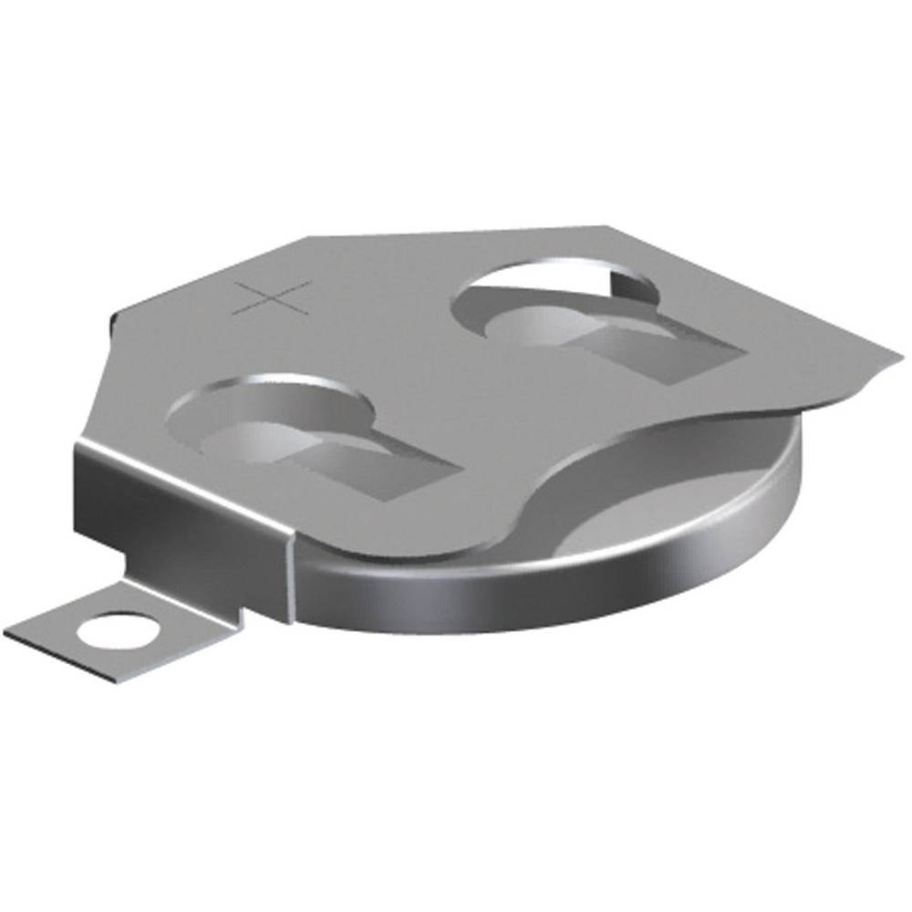
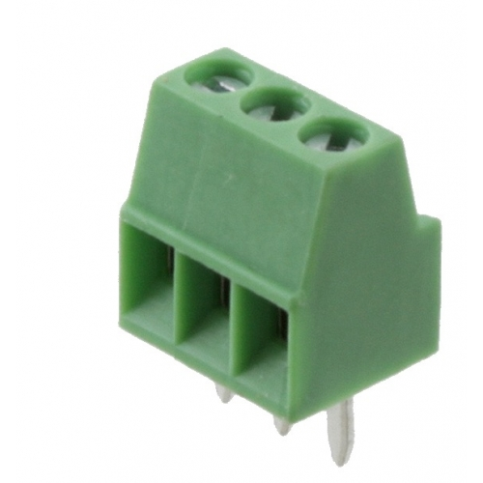
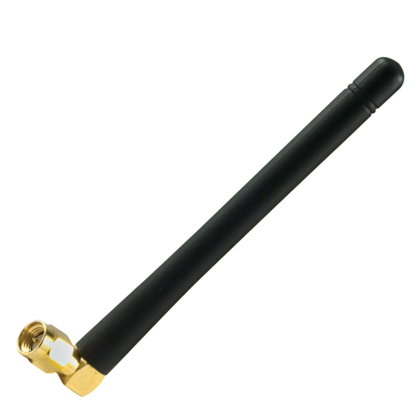
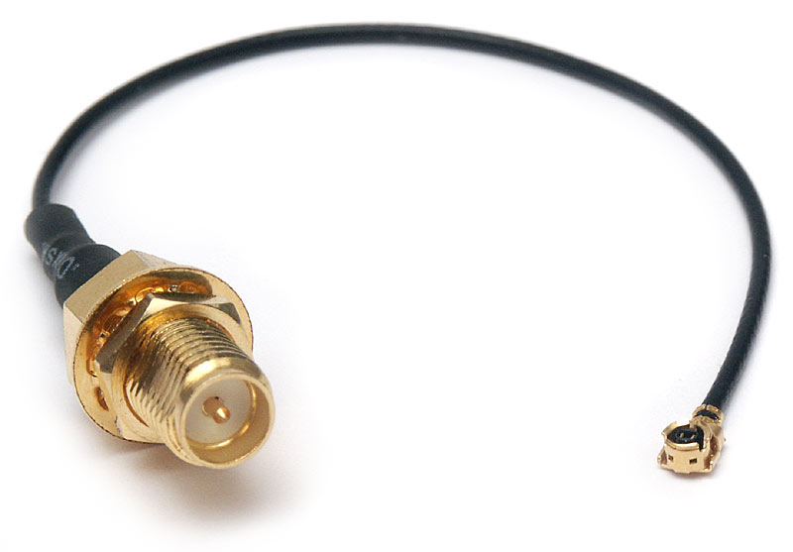
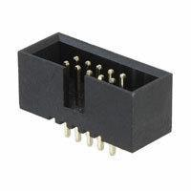
Digital Dust feature-set
GPIO headers
Pwr Mgnt
USB port
Radio Module (CC13xx) w/ uFL conn
JTAG
<number>

Slide 18
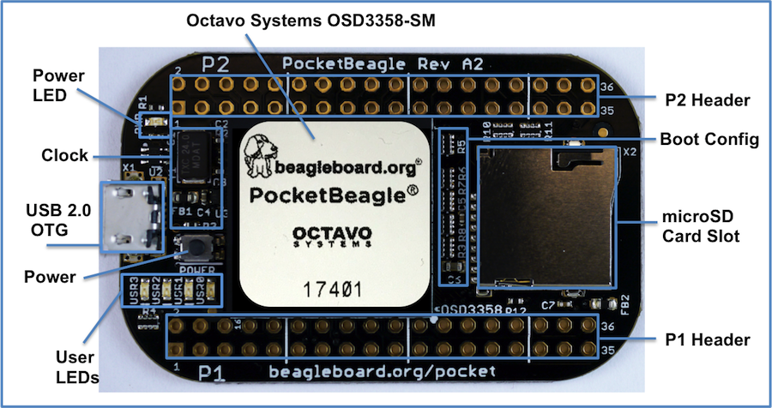
PocketBeagle top

Slide 19
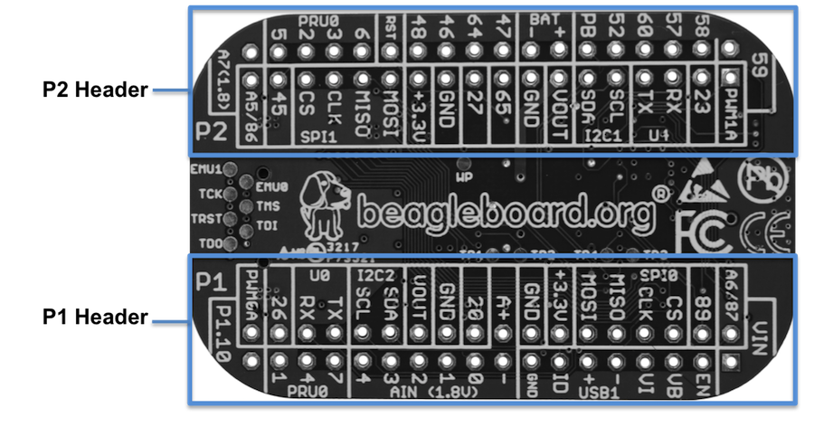
PocketBeagle bottom

Slide 20
PocketBeagle bottom
44

Slide 21
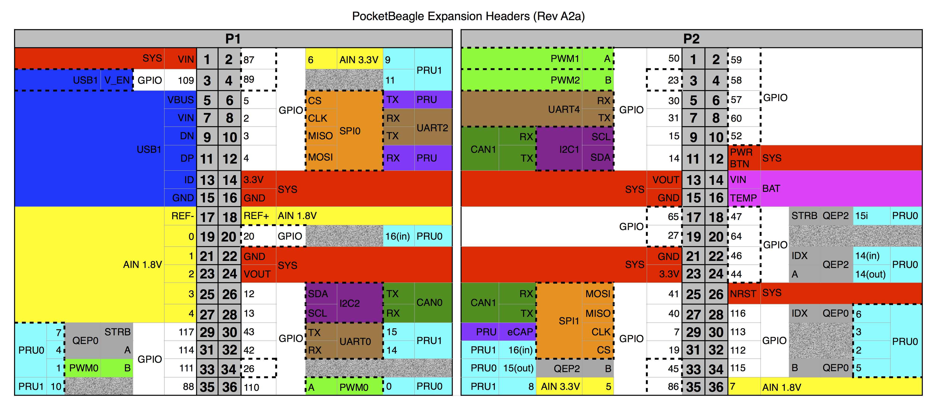
PocketBeagle expansion

Slide 22
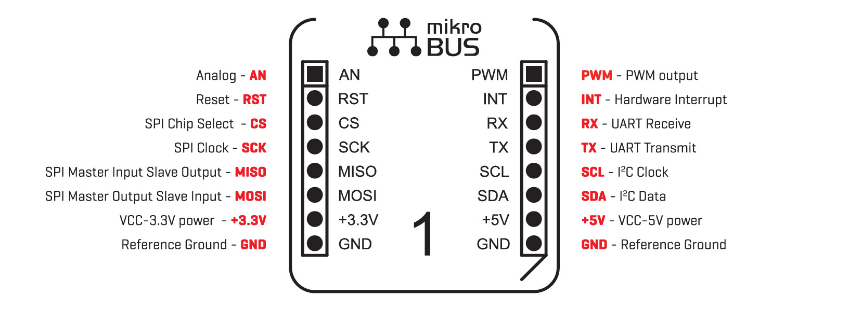
mikroBus Click

Slide 23
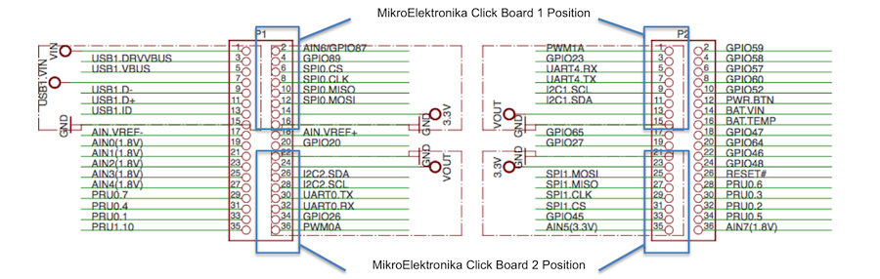
Connecting mikroBus Clicks

Slide 24
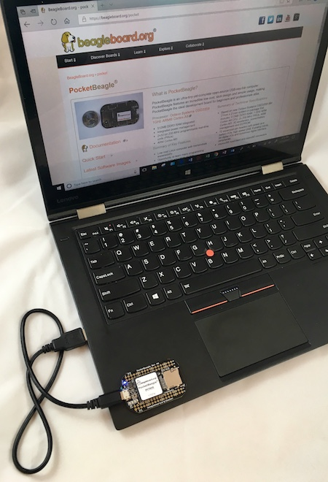
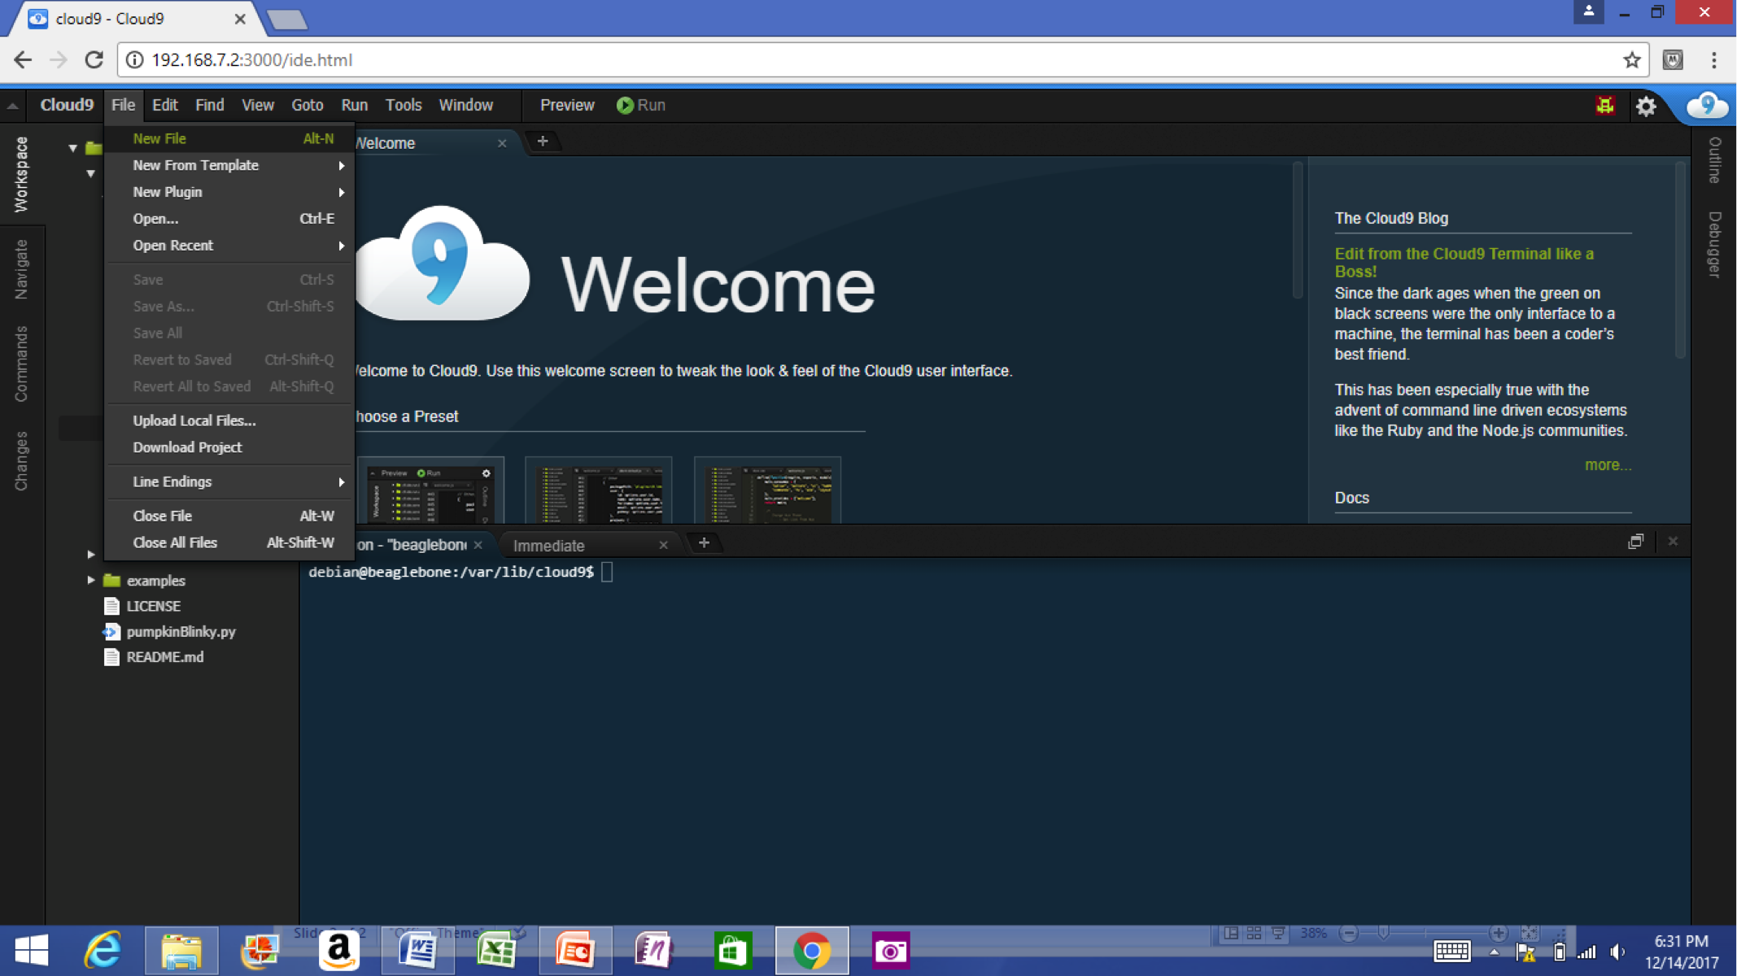
Single cable development
Power, network, develop
You can add a network and power many other ways

Slide 25
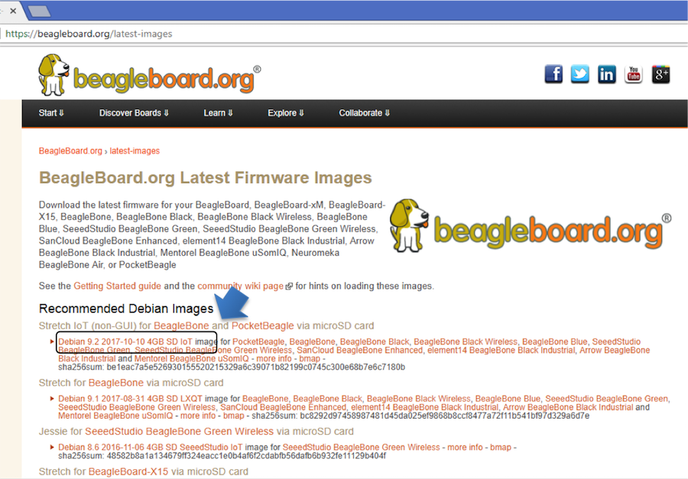
Download image

Slide 26
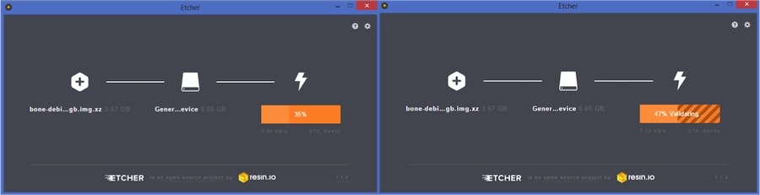
Write image to microSD with Etcher

Slide 27
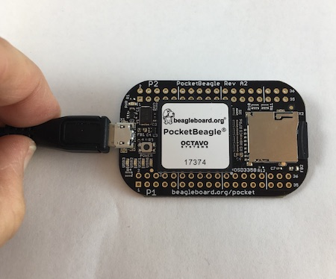
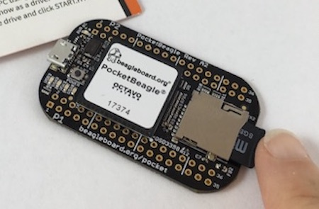
Insert microSD and boot

Slide 28
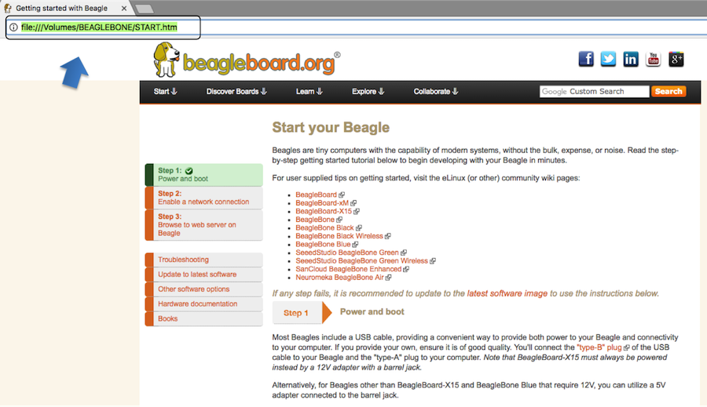
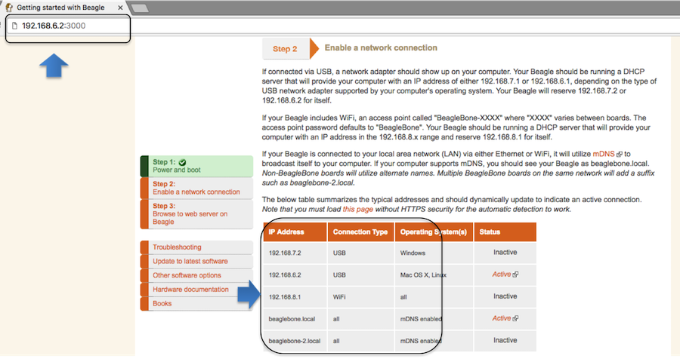
Connect to the USB network

Slide 29
Open the IDE

